Slide 1
Hypothesis list

Slide 2
Hypothesis list
From the ROAS Driver tree above we know the following:
#Orders = CVR x #Clicks
[CVR is The percentage of users clicking on an advertisement who end up placing an order.]
#Clicks = CTR x #Impressions
[An impression is a metric used to quantify the number of digital views or engagements of a piece of content, usually an advertisement, digital post, or a web page. Impressions are also referred to as an “ad view”. This is for online advertising]
[CTR is the percentage of users seeing an advertisement who click on that advertisement.]
Revenue generated by ads = AOV x #Orders
[AOV is The mean revenue generated by each order]
Ad spend = Cost per impression x #Impressions
ROAS = Revenue / Advertising spend
Thus,
ROAS would decline if the advertising spend is greater than the revenue generated by ads.
As both, the revenue generated by ads and the ad spend depend on the number of impressions, the number of impressions must be constant and not affect the calculations.

Slide 3
Hypothesis list
By assessing ROAS driver tree, we can outline a handful of root-cause metrics that may be driving the decline: Root Cause Analysis
Model answer: Hypothesis list
So, we concluded in the previous slide that,
ROAS would decline if the advertising spend is greater than the revenue generated by ads, and,
As both, the revenue generated by ads and the ad spend depend on the number of impressions, the number of impressions must be constant and not affect the calculations.
Advertising spend would be greater than the revenue generated by ads if,
CTR has declined (customers aren’t finding our ads as compelling, or we are not targeting the right customers)
CVR has declined (customers who click ads are not ordering from the website as frequently)
AOV has declined (individual customers are not ordering as much)
Cost per impression has increased (Maybe Facebook has increased ad prices)
Thus, these would be a list of hypotheses or root causes for the ROAS decline.

Slide 4
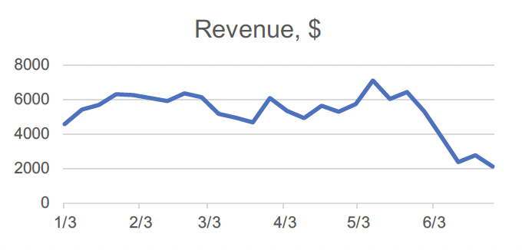
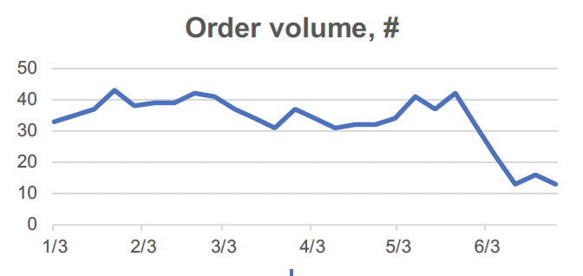
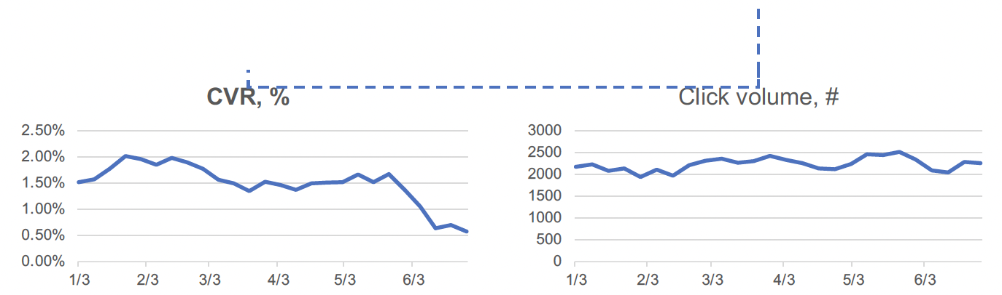
Data analysis and chart output
As suggested by similar chart trends, Revenue is down as a function of order volume:
Order volume is declining due to a drop in CVR from ~1.5-2 % to ~0.5-1 %
NOTES:
• The Excel chart dashboard did not include the CVR chart – I had to go look at the data manually and create a new chart for the slide.

Slide 5
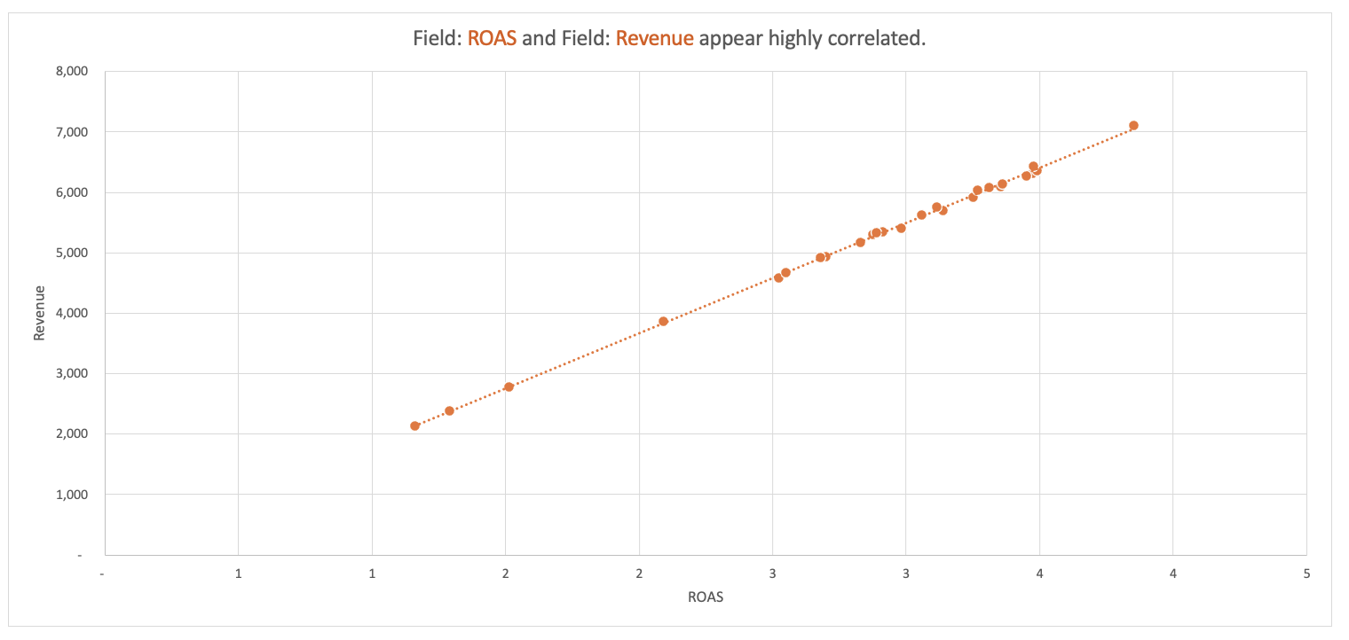
Data analysis and chart output
Analysis: Low ROAS is driven by decline in CVR

Slide 6
Findings and recommended next steps
Recommendations: We should design and pursue initiatives that directly
improve CVR to fix ROAS
Model answer: Findings and recommended next steps
We are experiencing a drop in ROAS due to a decline in CVR
• CVR has fallen by more than half, from ~1.5-2% at typical levels to ~0.6% in June 2022
• Other drivers of ROAS are relatively constant and do not require investigation
As next steps, we need to determine why CVR is declining and then deploy initiatives to restore CVR to
previous levels
• We can examine CVR for the Bedding and Bath division by business segment to further isolate the problem
driver
• Potential areas of investigation include out-of-stock rate, the lead time for products to ship, and pricing
We estimate root cause analysis and initiative design will require three weeks and require dedicated
resourcing from the marketing team
• Deploying one or two marketing analysts would allow us to scope a specific set of initiatives for early Q3
implementation
• Leadership will be consulted at various checkpoints before taking any courses of action

